Slide 1

Smart Parking Management System using Deep Learning
Sheece Gardezi
Michael Brown

Slide 2
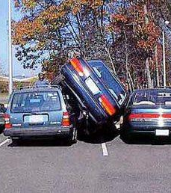
Problem
Finding a parking spot today:

Slide 3


Costs
Time wasted finding a parking spot
Money wasted on fuel
Higher infrastructure cost of existing solutions

Slide 4

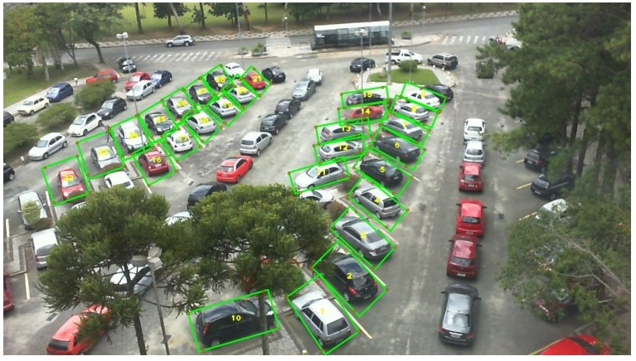
Deep Neural Network

Slide 5
Deep Neural Network
We used AI/ML and IoT (surveillance/traffic cameras) we will have built an application which shows customers which parking spaces are free and allows them to book and pay through the application for a specific parking spot.

Slide 6
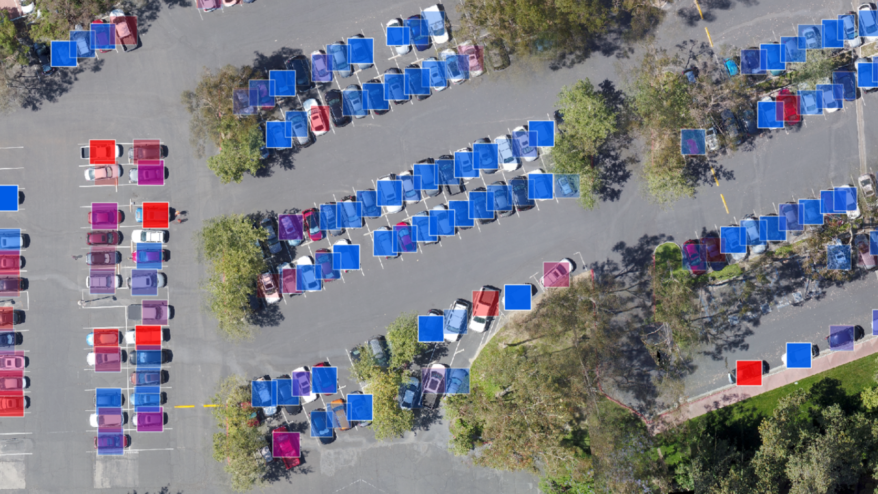
95%
Weather
Vicchels
Low res
Easy to set up

Slide 7
Benefits
Increase carpark utilisation rates
Reduced stress for commuters
Saving commuters money & time
Environmental benefits
less time spent looking for parking space
Increased safety

Slide 8
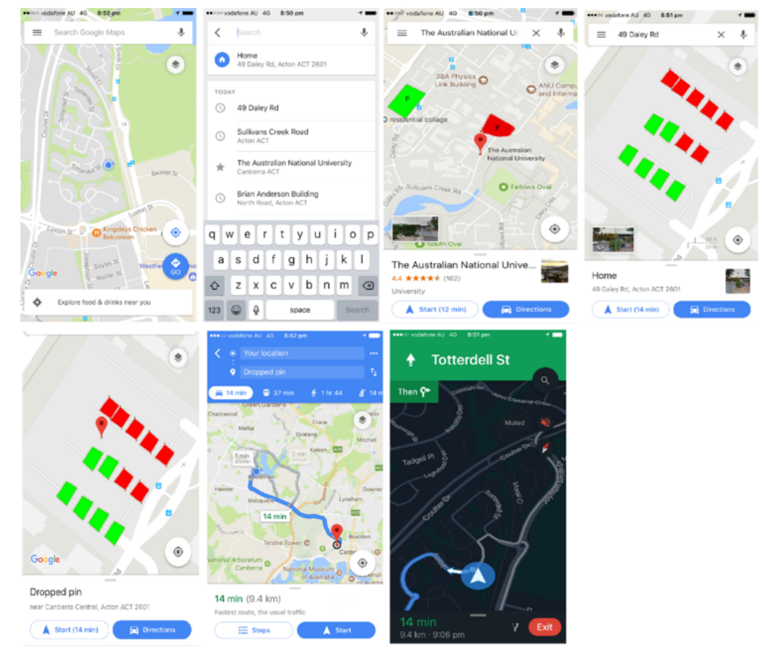
Project Extensions
API to google maps
Develop our own application
Find, book and pay for parking

Slide 9

Forefront of technology

